Slide 1
Lending Club Case Study
https://github.com/elcommselva/LendingClubCaseStudy.git
Selvakumar Karuppannan
IIITB ID:
Upgrad ID:

Slide 2
Lending Club Case Study Problem statement, How and What
Problem Statement:
Identify patterns which indicate if a person is likely to default, which may be used for taking actions such as denying the loan, reducing the amount of loan, lending (to risky applicants) at a higher interest rate, etc.
How:
Understand how “consumer attributes” and “loan attributes” influence the tendency of default
- Univariate and segmented univariate analysis
- Business-driven, type-driven and data-driven metrics are created for the important variables and utilized for analysis
- Bivariate analysis
- Appropriate plots
What:
In other words, the company wants to understand the driving factors (or driver variables) behind loan default, i.e. the variables which are strong indicators of default.
The analyses successfully identify at least the 5 important driver variables (i.e. variables which are strong indicators of default).
period 2007 to 2011.

Slide 3
Lending Club Case Study Approach
Data import
Data understanding
Data Cleaning
Data Segregation – Customer vs Loan related attributes
EDA
Inference

Slide 4
Lending Club Case Study Consumer & Loan Attributes
Consumer attributes
emp_length
home_ownership
annual_inc
verification_status
purpose
title
zip_code
addr_state
pub_rec_bankruptcies
open_acc
total_acc
pub_rec
pub_rec_bankruptcies
dti
dti_joint
Loan attributes
loan_amnt
int_rate
Term
issue_d
- Funded Amount vs Income + term

Slide 5
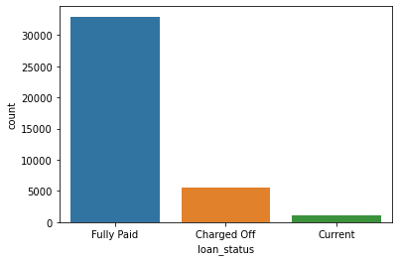
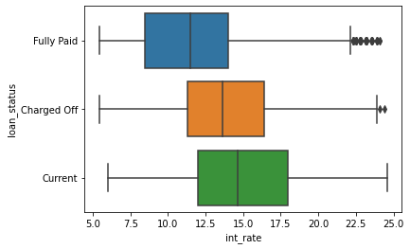
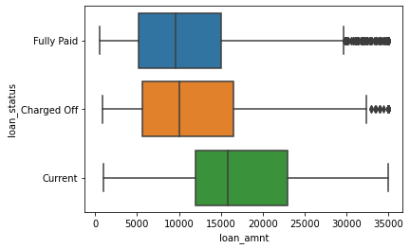
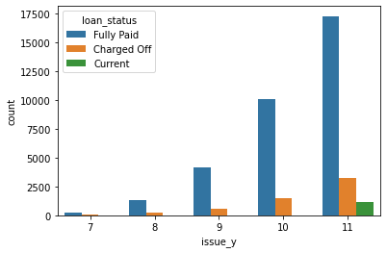
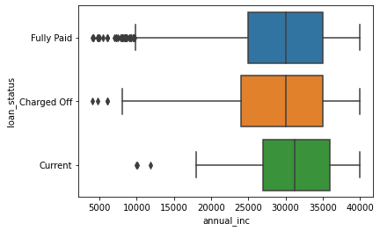
Lending Club Case Study Univariate and segmented univariate analysis
14.16 % of total loans are defaulted
Interest Rate is not directly influencing`g the default
Outliers in Interest Rate is not much and not influential
Loan amount b/w 5000 & 15,000 is either fully paid or Defaulted
Default % remains almost similar across Years
Annual income less than 25000 more likely to default

Slide 6
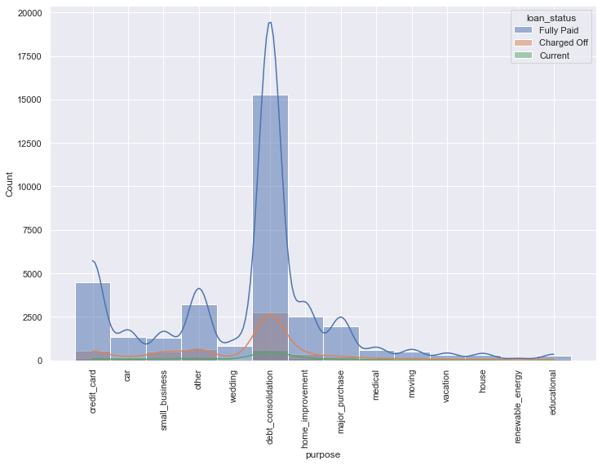
Lending Club Case Study Univariate and segmented univariate analysis
Customers who got loan for debt_consolidation has relatively defaulted more than other customers

Slide 7
Lending Club Case Study Bivariate analysis

Slide 8
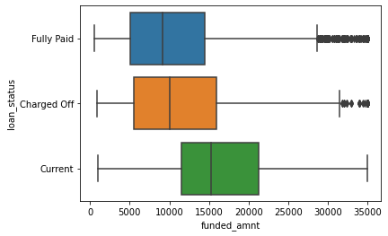
Lending Club Case Study Univariate and segmented univariate analysis
Row Labels | Count of loan_status
7 | 251
Charged Off | 45 | 17.93
Fully Paid | 206
8 | 1562
Charged Off | 247 | 15.81
Fully Paid | 1315
9 | 4716
Charged Off | 594 | 12.60
Fully Paid | 4122
10 | 11532
Charged Off | 1485 | 12.88
Fully Paid | 10047
11 | 21656
Charged Off | 3256 | 15.04
Current | 1140
Fully Paid | 17260
Grand Total | 39717
Row Labels | Count of loan_status
0 | 1075
Charged Off | 228 | 21.2093
Current | 42
Fully Paid | 805
1 | 7823
Charged Off | 1095 | 13.99719
Current | 146
Fully Paid | 6582
2 | 4388
Charged Off | 567
Current | 97
Fully Paid | 3724
3 | 4095
Funded amount b/w 5000 & 15,000 is either fully paid or Defaulted
% of Defaulters with emp_length NULL is higher than others
Not much pattern with respect to loan issued year

